Slide 1
Computer Organization 1
Instruction Fetch and Execute

Slide 2
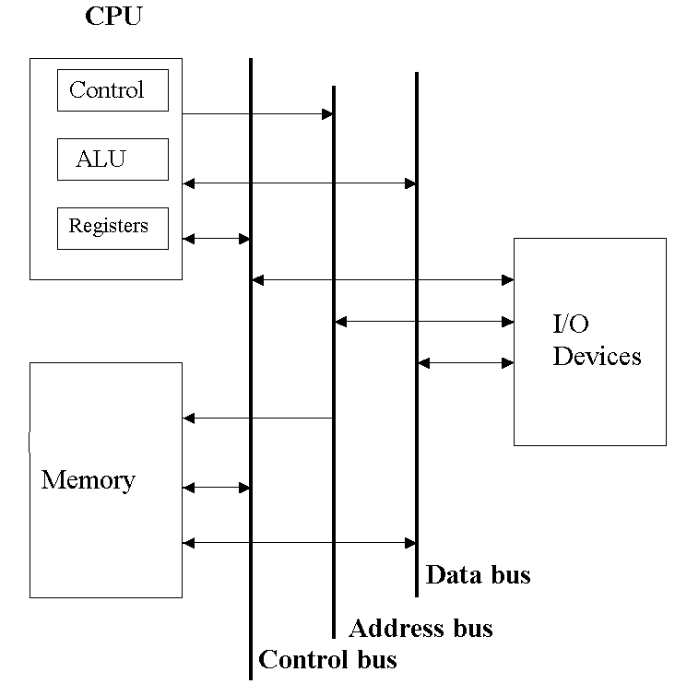
The System Bus Model

Slide 3
System Bus Model
The bus can be thought of as a ring round which control commands, data and addresses to access are sent. Each device has access to the signals on the bus, but each device must be authorized to accept a particular message.

Slide 4
Memory
Computer memory is arranged in a linear way, so that each byte in memory has its own address, numbered from 0 up to the last byte.
Thus, for a memory with 2^32 bytes, the first byte is found at address 0, and the last byte at address 2^32 –1.
In today’s PCs, it is usual to group bytes in 32-bit words
64-bit word machines are next.
We will use Murdocca and Heuring’s memory layout:

Slide 5
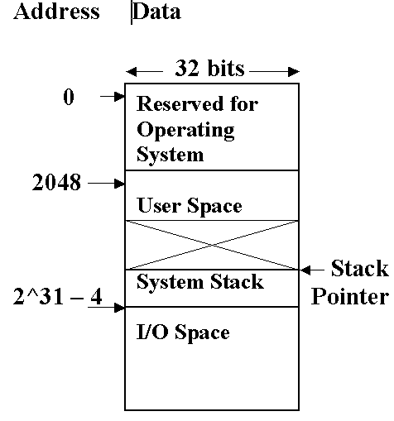

Slide 6
Memory
The size of the address determines the size of the memory.
For example, an 8 bit address size means that the memory is limited to 2^8 words (or bytes). That is, 256 locations.
A 16-bit address allows for a memory as big as 2^16 locations, that is, 65,536. That is, 64k, where k stands for 1024 - one kilobyte.
A 20-bit address - 1024 x 1024 gives 1,048,576 – 1MB
A 30-bit address allows for addressing 2^30 locations – 1 GB
32 bit address can address 4GB of storage

Slide 7
Memory
Memory addresses in a 16-bit machine are numbered from 0000 to FFFF hexadecimal
In 32-bit address machines, it is possible to have up to 2^32 locations (ie 4 Gigabytes) in memory. That is, from:
Address 0000 0000 to address FFFF FFFF hex

Slide 8
The System Stack
When a program (process) passes control to a subroutine (subprogram, method), all the program’s current values (PC, register contents, values of local variables) have to be parcelled up and saved until control returns from the method
These values are stored on the system stack until the process is reinstated

Slide 9
Central Processing Unit CPU
Consists of:
ALU (Arithmetic and Logic Unit),
The Registers (or Index Registers) - Local storage used as a ‘scratchpad’ for temporary storage during calculations
The Control Unit

Slide 10
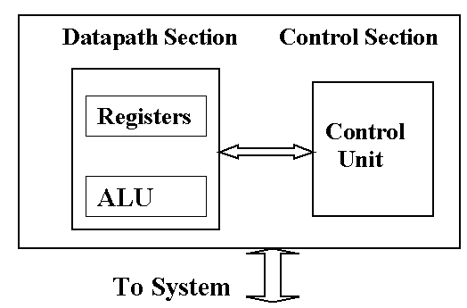
Central Processing Unit CPU
The Control Unit coordinates the operations of the Memory, CPU, buses and I/O - like a computer within a computer
There are several buses inside the CPU
The Datapath is made up of the ALU and the Registers

Slide 11
Fetch Execute Cycle
An instruction such as A = A + C; is translated into the computer’s Assembly Language (and then, Machine Language) form
This example, in Assembly, could be: ADD C, A
The program is in memory; instruction ADD C, A has to be copied into the CPU, and executed

Slide 12
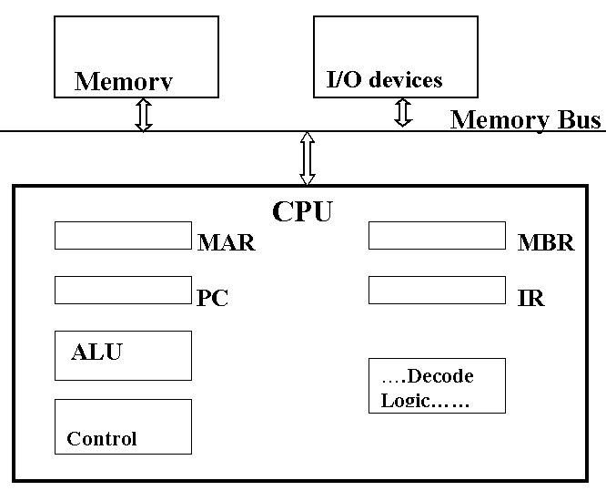

Slide 13
Instruction Fetch and Execute
1. Copy contents of Program Counter (PC) into MAR (Memory Address Register). The PC contains the address of the next instruction, ADD A, C to be executed.
2. Copy (MAR) to bus
3. Fetch the instruction ADD A, C to be executed into the MBR (Memory Buffer Register)
4. Copy the instruction into the IR (Instruction Reg.)

Slide 14
Instruction Fetch and Execute
5. Split the instruction into opcode ADD, and operands A,C using the decode logic: if the instruction requires data, (here, A and C) copy the operand address A on to the MAR, and fetch the data from memory; fetch C; do the add, put the result back into memory at A
6. update the PC
7. Go to step 1. (Copy contents of Program Counter (PC) into MAR)

Slide 15
Index Registers
The registers are a set of memory locations local to the CPU
  quick to access
  used as temporary storage for intermediate results
  each register has its own address within the CPU.
Typical register numbers vary from a few to several thousand.
Each register has its own address, starting from zero.
Register addresses are much smaller than memory addresses:
for example, 32 registers would require only a 5-bit address.
Instructions which operate on registers can run about ten times as fast as instructions which access memory.

Slide 16
The Special Registers
Program Counter (PC) keeps the memory address of the next instruction to be executed
Instruction Register (IR) holds the current instruction being implemented
Stack Pointer holds the address of the system stack
Program (or Process) Status Word (PSW) has 4 condition codes; these are bits which are set by the last instruction. N, Z, C and V.
N is set on (to 1) by a negative result; Z is set on by a zero; C is set by a Carry out from the ALU, and V (oVerflow) is set when the result from an arithmetic operation is too large to be handled by the ALU

Slide 17
Big & Little Endians
Different ways of labelling storage
Left-right vs. Right-left
Big-Endian - most significant byte of any multibyte data field is stored at the lowest memory address
Little-Endian - least significant byte of any multibyte data field is stored at the lowest memory address

Slide 18
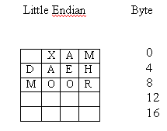
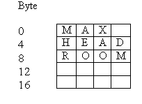
Big-Endian v Little-Endian

Slide 19
Summary
The memory in a computer is arranged in a linear fashion, each byte numbered with its address, starting at zero. The top part of the memory is occupied by the operating system, then there is a user area for programs and data; the system reserves areas for a system stack, and for I/O operations.
Instructions are implemented by a Fetch-Execute cycle.

